Slide 1

MALIGNANT COMMENT CLASSIFICATION PROJECT
By,
ALBIN STABHY P

Slide 2
Contents :
Problem Statement
Understandings
EDA
Visualizations
Steps
Finalized Model
Conclusion

Slide 3
Problem Statement:
This is a project related to social media online comments. Now a days most of the social media platforms give right to people to express their opinions. But the same time online has emergence of conflict, hate, described in abusive language, aggression, cyberbullying, hatefulness.
This can take a toll on anyone and affect them and leads to mental depression, mental illness, anxiety, isolation and even suicidal thoughts.
This project is to build a prototype of online hate and offensive comment classifier which can used to classify hate and offensive comments so that it can be controlled and restricted from spreading hatred and cyberbullying

Slide 4
Understandings:
This is a regression model data.
The dataset is in the csv file format. And it is in two different csv files. One is for train the data(train.csv) and the other is for testing the data(test.csv).
Train data have 159571 instances and 8 attributes and for test data there are 153164 instances and 2 attributes.
There is no missing values in both the dataset.
The data for training and testing is in the form of comments which are of object datatype.
The model want to predict the probability of comments to be ‘malignant’, highly_malignant’, ‘rude’, ‘threat’, ‘abuse’, ‘loathe’ of the test data

Slide 5
Understandings:
8 columns and what they denotes:
id: it includes unique ids associated with each comment text given
comment_text: This column contains the comments extracted from various social media platforms
malignant: It is the Label column, which includes values 0 and 1, denoting if the comment is malignant or not
Highly_malignant: It denotes comments that are highly malignant and hurtful.
Rude: It denotes comments that are very rude and offensive.
Threat: It contains indication of the comments that are giving any threat to someone
Abuse: It is for comments that are abusive in nature.
Loathe: It describes the comments which are hateful and lathing in nature

Slide 6
EDA (Exploratory Data Analysis):
Check whether any nan values present or not. And there is no null values in this dataset.
Then clean the comments by cleaning the the urls, removing the punctuations and remove the numbers and new line command.
After that, done the preprocessing using word tokenization, lemmatization, removing the stopwords from the comment.
After doing the NLP part the comment_text is then inside the list. So it is again converted to object datatype using the function str_converter.
Then plot the wordcloud of word comes under malignant category and words comes under loathe category

Slide 7
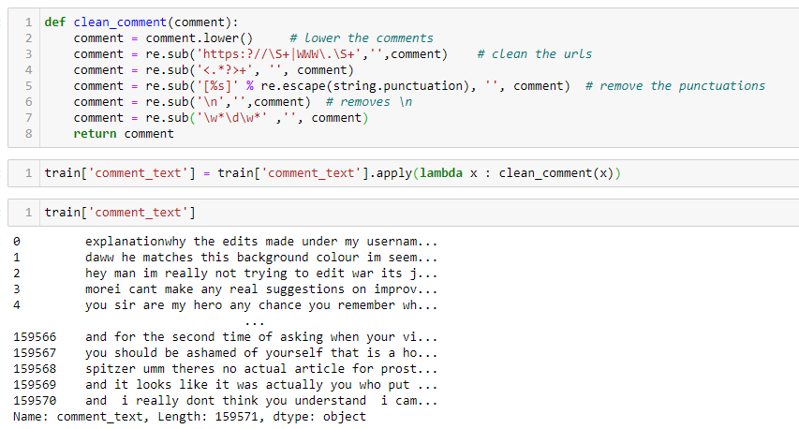
Cleaning the comment:

Slide 8
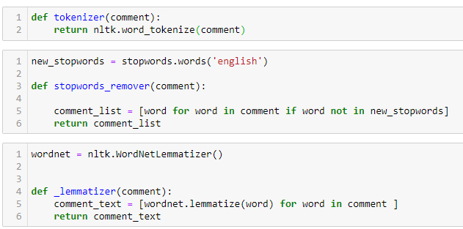
Pre-processing comments using word_tokenization, lemmatization, stopwords removal

Slide 9
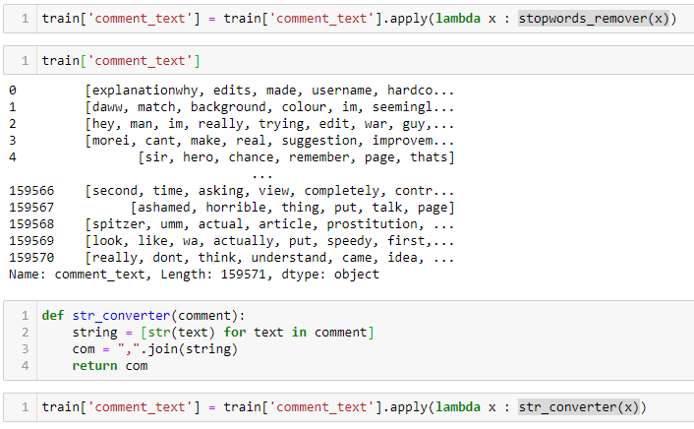
Coverts the list datatype to object datatype

Slide 10
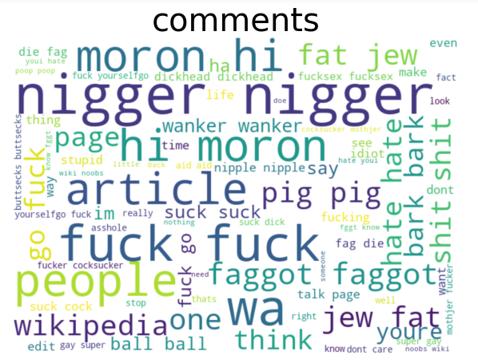
Visualization:
Words comes under malignant category

Slide 11
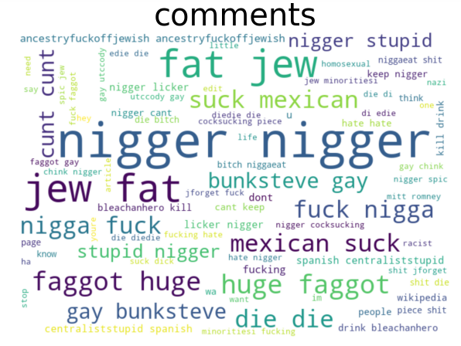
Visualization
Words comes under the loathe category

Slide 12
Steps Followed In The Project:
Data import
Check the datatypes of all the columns
Check for the null values in the dataset
Clean the comment_text using different functions for getting the maximum accuracy
Plot the wordcloud of word comes under malignant category and words comes under loathe category
Join the comments of both datasets for predicting the values for the test part
Initiate LogisticRegression model.
Cross validate the model by giving the values of target columns.
Find the cv score of all the features.
Take the mean cv_score of all the features.
Predict the probability of comments to be malignant, highly malignant, rude, threat, abuse, loathe for the test_data
Saves the model in a pickle file named ‘malignant_classification_submisson.csv’.

Slide 13
Finalized Model:
The models tested: LogisticRegression
The model is cross validated again and then take the mean of each 6 features.
Mean cv_score of malignant is 0.9734046
Mean cv_score of highly_malignant is 0.9871293
Mean cv_score of rude is 0.9866448
Mean cv_score of threat is 0.9833735
Mean cv_score of abuse is 0.0788214
Mean cv_score of loathe is 0.9822291
The mean of the above 6 is calculated as the cv_score and gets the score of 0.9819338

Slide 14
Conclusion:
Created a model that have 98% probability accuracy to classify the comments according to the nature of language used
This model is created mainly for the online social media platform that have the ability to type comment. This will help many people and celebrities to who are at the edge of going to mental depression, mental illness, lonliness and thoughts of suicide to get over it.
This will be a great success for all the companies who gives the chance to public express their opinion when it gains 100% accuracy

